Slide 1


My Path, My Story: An Autobiography
Life is a fascinating journey filled with twists, turns, and unforgettable moments. As I look back on my own path, I am reminded of the diverse experiences that have shaped me into the person I am today. This autobiography is a glimpse into my life, a collection of moments and mosaics that have left an indelible mark on me and those around me.

Slide 2

Early Years: A Harmonious Childhood
Family Bonds
My early years were characterized by a harmonious upbringing, rich in the bonds of family, friendships, and a strong sense of community. I grew up in a close-knit village, where life was simple, and the values of unity and togetherness were deeply ingrained.
Cousins and Friends
I was fortunate to have cousins and childhood friends as neighbours. We shared a unique camaraderie that added a special dimension to my upbringing. Together, we explored the village, climbed trees, played games in open fields, and embarked on countless adventures.
Village Playgrounds
Our village had its share of playgrounds, which were the epicentre of our youthful joy. These open spaces became our canvas for creativity, imagination, and endless games. From playing tag to organizing mini-sports events, these playgrounds were where we learned the values of teamwork, sportsmanship, and the exhilaration of friendly competition.
Helping Our Parents
In our close-knit community, it was a common practice for children to assist their parents with daily chores. I eagerly participated in helping my parents with household tasks, such as fetching water from the communal well, tending to the garden, and taking care of our animals.

Slide 3

Childhood Memories
1
Grandparents' Stories
One of my fondest childhood memories is the time I spent with my grandparents. They lived in a small village in the countryside of Gitare, Embu, and I would spend my holidays with them. I remember the long walks to the river to fetch water, the afternoons spent playing games with the local children, and the evenings spent listening to my grandparents' stories about their lives and experiences.
2
Community Service
Another memorable experience from my childhood is the time I spent participating in community service activities. I was part of a local youth group that organized community clean-ups, visited the elderly, and provided support to those in need. These experiences taught me the importance of giving back to the community and the value of service.
3
Cultural Appreciation
Growing up in the diverse and culturally rich tapestry of Kenya, I developed a deep appreciation for our country's traditions and heritage. I eagerly participated in cultural festivals and celebrated Kenyan holidays with my classmates and family.
4
Simple Pleasures
We enjoyed storytelling sessions under the starry night sky, participated in cultural festivals, and celebrated traditional holidays with fervour. These experiences nurtured an appreciation for our heritage and instilled a sense of belonging to the rich tapestry of our village life.

Slide 4

Introduction to Faith
Early Years of Faith
1
I grew up in a household where the values of faith, love, and compassion were a way of life. My parents were devoted Church members, and they imparted their spiritual beliefs to me from a young age. I was surrounded by religious symbols, attended service regularly with my family, and learned the stories of the Bible at bedtime.
2
Eager to Get Baptized
As a child, I was eager to embrace working for God faith fully. I admired the rituals, the beauty of the church, and the sense of community that came with it. The idea of baptism, in particular, fascinated me. I couldn't wait to take this important step and officially become a part of the born again community.
Baptism at Age 4
3
My dream of getting baptized became a reality at the age of 4. I was baptised while attending National Interdependence Church of Africa . The day of my baptism was a memorable one. I stood in front of my family, godparents, and members of the congregation. As the holy water touched my forehead, I felt a profound sense of belonging to the christian faith.
4
Confirmation at Age 12
As I continued to grow in my faith, I looked forward to the sacrament of Confirmation. It was a significant milestone in my spiritual journey. Still at the age of twelve, I underwent the sacrament of Confirmation, offered to me by the then Arch-Bishop of the National Interdependence Church of Africa, Diocese of Nairobi .

Slide 5




Education and Growth
Founders Academy
I started school at 4 years of age, at Founders Academy . From there ByGrace Primary School, then transferred to Elimika Primary School,from there I joined Kamuthatha Boarding Primary Schoo then Newlight Senior Boys High School and finally my tertiary education at Dedan Kimathi University of Technology.
Kamuthatha Boarding Primary School
In 2012 I joined Kamuthatha Booarding Primary school from class 5 till I sat for my KCPE
Newlight Senior Boys High School
I completed my primary education with flying colours and earned a spot in a prestigious high school. My dream was to become an architectural engineer, following in the footsteps of my parents, who have been my role models throughout my life.

Slide 6
Secondary Education
Academic Challenges and Triumphs
Extracurricular Activities
Sports and Leadership
New Light Senior Boys High School wasn't just about academics; it was a place where I had the opportunity to explore my interests beyond the classroom. I joined the debate club, where I honed my public speaking skills and learned the art of persuasive argumentation. This club not only boosted my confidence but also instilled in me a passion for critical thinking.
As I entered my sophomore year, I discovered my love for sports. I joined the school's Table-tennis team and took part in various inter-school competitions. Tennis became my outlet, a way to release the stress that sometimes accompanied the demands of academics.
Secondary school was a whole new world, and I quickly realized that the academic challenges were a step up from primary school. Subjects became more specialized, and the workload increased. In those early years, I faced my fair share of academic hurdles. Biology continued to be a challenging subject, but I was determined to conquer it.

Slide 7
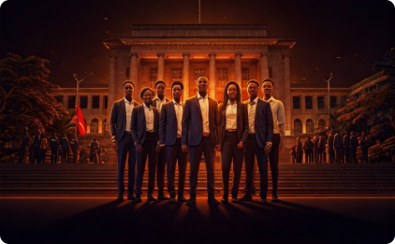
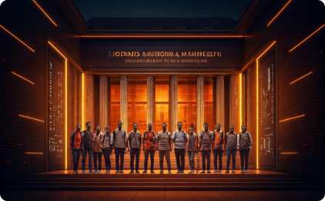
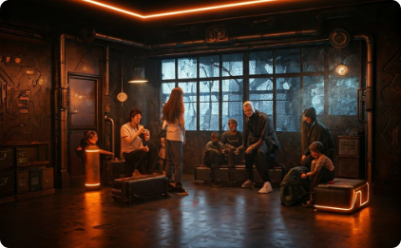
Exploring Beyond the Classroom: Academic Trips
National Assembly
National Museum
Orphanage Visit
In Form 4, I had the privilege of joining a history trip to the National Assembly in Nairobi. It was a day filled with awe and inspiration as we explored the heart of Kenya's political landscape. Walking through the corridors of power, we gained a first-hand understanding of our country's governance and the democratic process.
The National Museum trip was another unforgettable experience. We embarked on a journey through time, delving into the rich history and cultural heritage of Kenya. It was here that I realized the beauty of our diverse nation's history, traditions, and archaeological wonders.
In Form 3, we took a day to visit a local orphanage. This trip was more than just an outing; it was an opportunity to give back and connect with the less fortunate in our community. We engaged in activities, shared stories, and lent a helping hand to those in need.

Slide 8
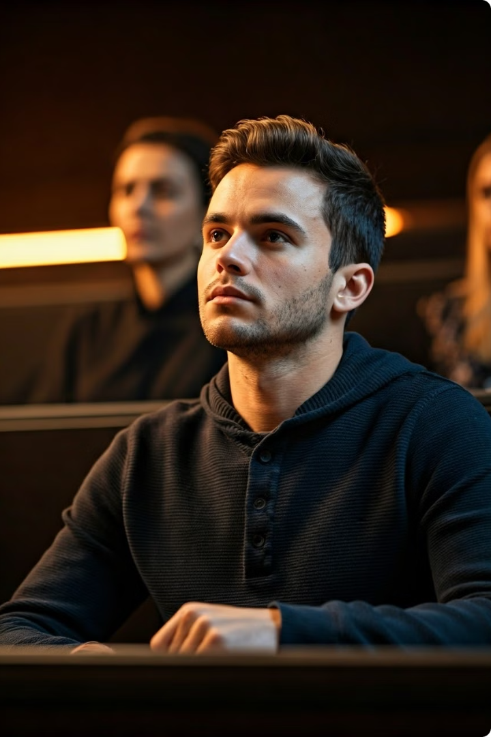
University Journey: Dedan Kimathi University of Technology
Academic Pursuits
My academic journey in university has been an exciting and intellectually stimulating one. Business Information Technology is a dynamic field that combines business management principles with cutting-edge technology.
Research and Innovation
In the world of Business Information Technology, research and innovation are paramount. My involvement in research projects and innovative initiatives allowed me to delve deeper into this dynamic field.
Extracurricular Activities
Beyond academics, I immersed myself in a range of extracurricular activities at the university. I joined the university's DSAIC club, which provided a platform for like-minded students to exchange ideas and develop technical skills.

Slide 9





Pursuing Faith and Community Service in University
Deepening My Faith
In university, I sought opportunities to further explore and strengthen my Christian faith. The campus had a vibrant Christian Union, and I eagerly became a part of it. Attending Christian Service on campus and participating in spiritual events allowed me to connect with like-minded peers who shared a common belief and a commitment to their faith.
Involvement in Christian Union Groups
I joined the Christian Union Association at the university, which provided a platform for spiritual growth and community service. As a member, I actively participated in organizing prayer sessions, retreats, and discussions that allowed us to explore our faith more deeply.
Joy in Giving Back
Participating in community service was a source of immense joy and fulfilment. We organized food drives, visited orphanages, and contributed to local development projects. These experiences reminded me of the importance of empathy and kindness and reinforced my commitment to making a positive impact on the lives of others.
Balancing Faith and Academics
Balancing my faith, academics, and community service was a rewarding challenge. It taught me valuable lessons in time management, organization, and the importance of prioritizing my commitments.

Slide 10

Challenges and Triumphs
The university journey was not without its challenges. Balancing academic responsibilities with extracurricular activities and personal life sometimes felt like a juggling act. However, these challenges served as opportunities for growth and resilience. Overcoming obstacles and setbacks has made me a more determined and resilient individual.

